Slide 1














IoT Protocols
Instructed by
Masud Rana
Lecturer,
Dept. of Cyber Security,
Bangabandhu Sheikh Mujibur Rahman Digital University
Presented by
Farha Islam Jitu
ID : 2101023
Dept. of IRE

Slide 2
Table of Contents:
MQTT
AMQP
CoAP

Slide 3
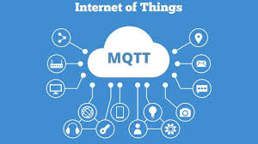
MQTT Protocol
MQTT refers to
“Message Queuing Telemetry Transfer”

Slide 4

Why MQTT was developed?
Before 1999 & until inventing MQTT,
Oil and Gas industries was facing troubles to exchange their data
from pipelines to SCADA systems.
Mediums of exchanging data:
Serial Communication
Satellite
Radio wave system
Problems:
Low Bandwidth
High Latency
Unreliable Connections
High Power Consumption
In Late 1999,
MQTT was invented by IBM

Slide 5
Characteristics of MQTT
01.
02.
Lightweight and Efficient
Small Header size
Publish-Subscribe Model
Event-Driven
Scale to Millions of Things
03.
Reliable Message Delivery
Minimize the risk of data loss
04.
Security Enabled
Encrypt messages using TLS
Authenticate clients using modern authentication protocols like OAuth
05.
Low cost
Low bandwidth

Slide 6
MQTT Components:
Broker: The Server that handles the data transmission between the clients
Topic: The location from/to where a device want to put or retrieve a message e.g. Home,Room1,Temperature.
Message: The data that a device receives “when subscribing” from a topic or send “when publishing” to a topic.
Publish: The process a device does to send its message to the broker.
Subscribe: The process a device does to retrieve a message from the broker.
.

Slide 7
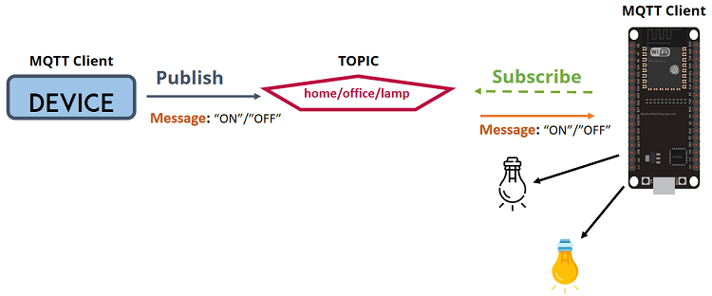
MQTT TOPIC:
Suppose, you have a device that publishes “on” and “off” messages on the home/office/lamp topic and another device that controls a lamp (like ESP32).
The ESP32 that controls your lamp, is subscribed to that
Topic: home / office / lamp.
So, when a new message is published on that topic, the ESP32 receives the “on” or “off” message and turns the lamp on or off.
.

Slide 8
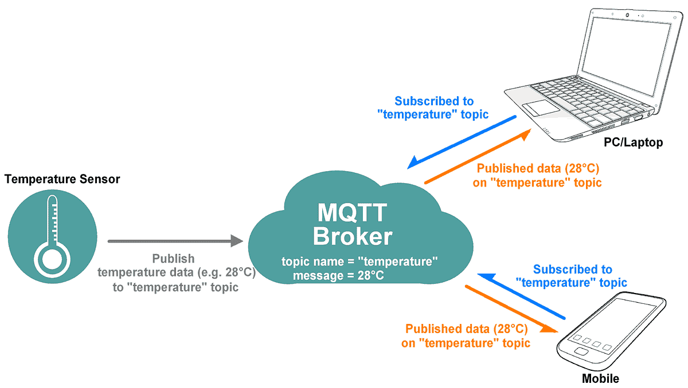
Architecture:
.

Slide 9
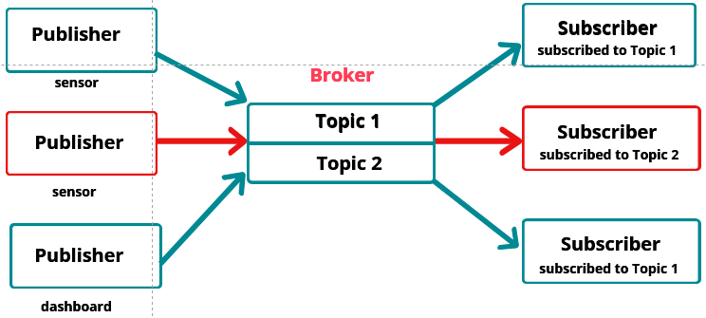
Publisher-Subscriber Relationship
.

Slide 10
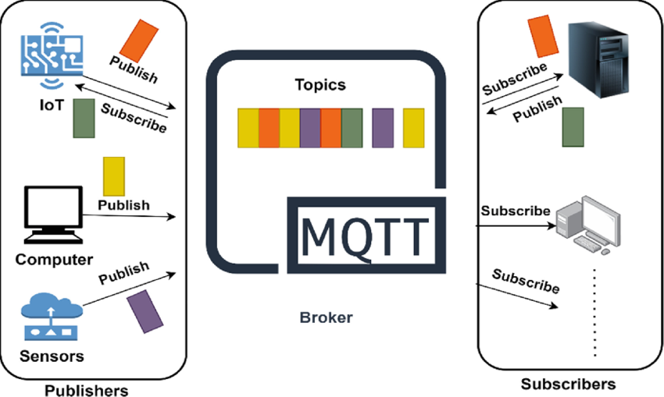
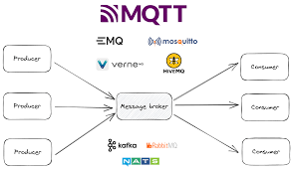
MQTT Brokers
“Heart of any publish/subscribe protocol”
It is responsible for:
Receiving all messages
decide who is interested in a topic
publishing the message to all subscribed clients.
Authentication and authorization of clients
.
Well known MQTT Brokers:
Mosquitto
Flespi
HiveMQ
Mosca

Slide 11
How MQTT Server/Broker Works??
.
There are four primary MQTT Control Packets that a client and server can use to communicate:
Connect → The first packet sent from the client to the server in order to establish a connection.
Disconnect → The final packet sent from the client to the server that indicates why the connection is being closed.
Subscribe → A subscribe packet is always sent from the client(subscriber) to the server to create one or more topic subscriptions.
Publish → A publish packet is sent from the client to the server(publisher) transporting an application message or from the server to a client which has subscribed to the respective topic.

Slide 12
Applications
Facebook currently uses MQTT for its Messenger app
Major cloud services providers, including Amazon Web Services (AWS), Google Cloud, IBM Cloud and Microsoft Azure support MQTT.
Real-time analytics
preventative maintenance and monitoring in environments including smart homes, healthcare, logistics, industry and manufacturing.
.

Slide 13
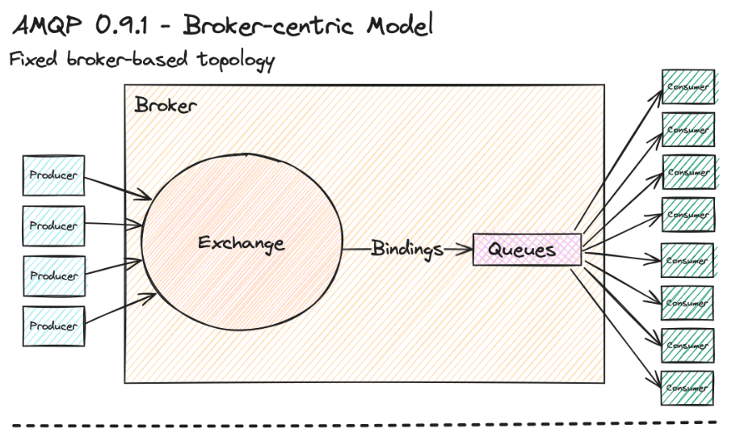
AMQP
“Advanced Message Queuing Protocol”

Slide 14
Characteristics of AMPQ
Interoperability
Vendor-Neutral
Supports Different Programming Languages and OS
Standard Message Format (JSON,XML etc)
Reliability
Message Acknowledgement
Message Persistence
Durable Queues
Uses TCP as its transport layer protocol
Security
Authentication
Encryption
Access control
High Performance
Low latency
High throughput

Slide 15
Why AMQP was developed?
AMQP was developed to meet the bank’s need (a reliable and secure messaging protocol).
It was later formalized as an open standard by OASIS (Organization for the Advancement of Structured Information Standards) making it vendor-neutral and widely adopted across various industries.
Problems:
Vendor Lock-in
Lack of Standardization
Message Loss
Limited Interoperability
Security Issues
In early 2000s ,
AMQTP was invented by JP Morgan Chase

Slide 16
COMPONENTS
Producer → Sends messages to the broker.
Consumer → Receives and processes messages from the broker.
Broker → Manages message queues, routing, and delivery.
Queue → Stores messages temporarily until consumed.
Exchange → Routes messages to appropriate queues.
Binding → Defines the relationship between exchanges and queues.
Routing Key → Used by exchanges to route messages to queues.
Virtual Hosts (vhosts) → Isolate resources in the broker for multi-tenancy.

Slide 17
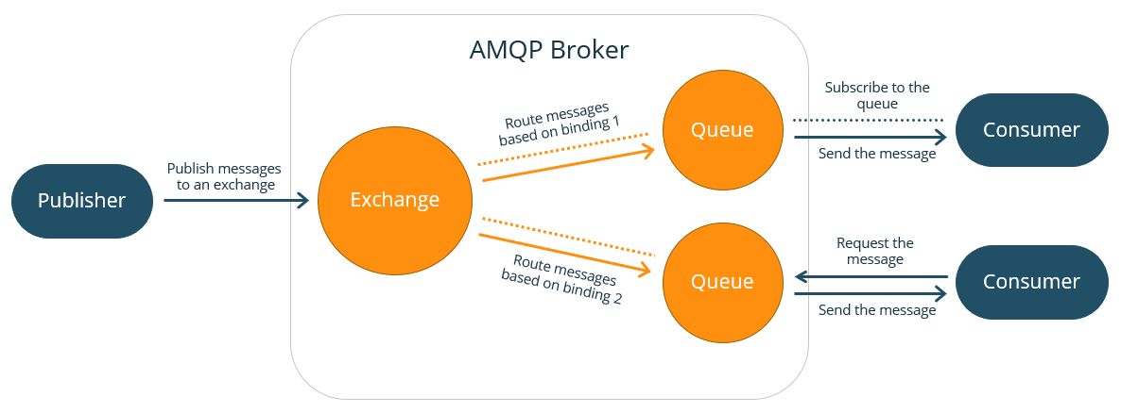
Architecture:

Slide 18
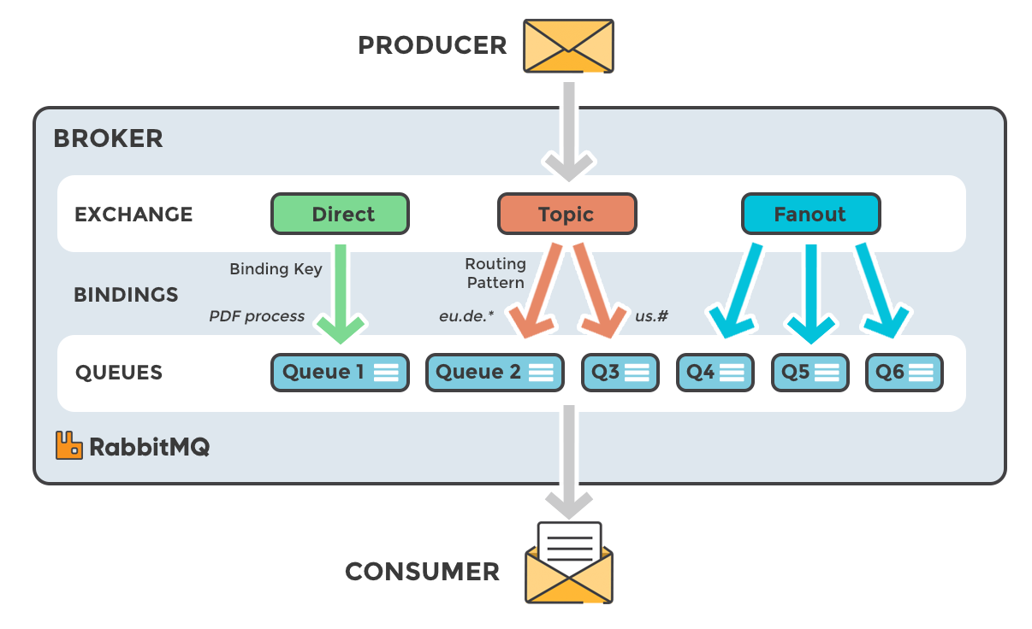
Architecture:

Slide 19
CoAP
“Constrained Application Protocol”

Slide 20
Why CoAP was developed?
CoAP is designed for devices and networks that have limited resources like low power, memory, and bandwidth, which is common in IoT (Internet of Things) devices.
Limited Memory: Devices like sensors and wearables with small memory that need to send minimal data efficiently.
Limited Power: Battery-powered devices such as smart locks and environmental monitors that require low energy usage for long-lasting operation.
Low-Bandwidth: Devices like agricultural sensors or weather monitoring devices that transmit small amounts of data over long distances, where communication speeds are slow.

Slide 21
Characteristics of CoAP
Lightweight
Efficient for Low Bandwidth Networks
Small messages
Consumes lower energy
Low Communication Overhead
Uses UDP which does not need handshaking
So, it is simple and fast
Optimized for Low-Power Devices
Does not require powerful hardware
Ideal for devices with low processing power and limited memory, such as battery-powered sensors.
Both Synchronized and
Asynchronous Communication
Security
DTLS (Datagram Transport Layer Security) encrypts data.
It ensures data integrity, so the data isn’t changed during transmission.
Verifies authentication of devices, preventing unauthorized access.

Slide 22
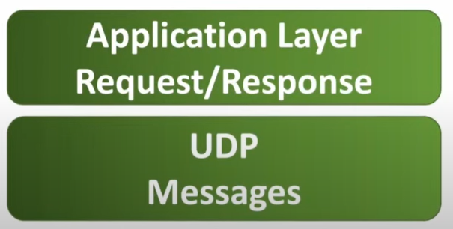
CoAP Layers:
CoAP is divided into two layers.
Upper Layer (Application Layer) is designed for the communication method based on the Request-Response model.
Lower Layer (UDP) is designed to deal with UDP and asynchronous messages.

Slide 23
Applications
.
Smart Home Automation
Environmental Monitoring
Industrial IoT (IIoT)
Agriculture and Smart Farming
Smart Cities
Healthcare
Asset Tracking

Slide 24
Message Types
Confirmable (Reliable)
Non-confirmable (Unreliable)
Aknowledgement
Reset

Slide 25
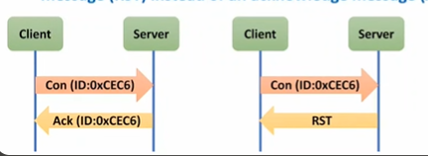
Confirmable Message (Reliable Message) \ Con:
A Confirmable message requires a response, either a Positive Acknowledgement or a Negative Acknowledgement.
If acknowledgement is not received then retransmissions are made until all attempts are exhausted.
The Acknowledgement message contains the same ID as the confirmation message.
If the server has trouble managing the incoming request, it can send back a reset message (RST) instead of an acknowledge message (ACK).

Slide 26
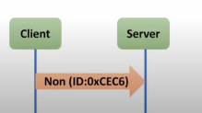
Non-confirmable message (Unreliable) / Non :
A Non-confirmable message doesn't require a response in the form of Acknowledgement.
These messages do not contain critical information, like a request for a sensor measurement made in periodic basis.
Even if one value is missed, there is not too much impact.
Even if these messages are unreliable, they have a unique size of 4 byte; 2bytes are for ID(label).

Slide 27
Acknowledgement (Ack):
It is sent to Acknowledge to a confirmable message (Con).
Reset (RST):
It represents Negative Acknowledgment.It generally indicates some kind of failure, like unable to process received data.

Slide 28


